Slide 1
Evaluating Model Performance

Slide 2
Evaluating student performance
Evaluating employee performance
Evaluating machine learning algorithm performance

Slide 3
Measuring performance for classification
Evaluating the performance of any medical test
The goal of evaluating a classification model is to have a better understanding of how its performance will extrapolate to future cases.
Though we've evaluated classifiers in the prior chapters, it's worth reflecting on the types of data at our disposal:
• Actual class values
• Predicted class values
• Estimated probability of the prediction

Slide 4
The actual and predicted class values may be self-evident, but they are the key to evaluation. Just like a teacher uses an answer key to assess the student's answers, we need to know the correct answer for a machine learner's predictions. The goal is to maintain two vectors of data: one holding the correct or actual class values, and the other holding the predicted class values. Both vectors must have the same number of values stored in the same order. The predicted and actual values may be stored as separate R vectors or columns in a single R data frame.

Slide 5
Obtaining this data is easy. The actual class values come directly from the target feature in the test dataset. Predicted class values are obtained from the classifier built upon the training data, and applied to the test data. For most machine learning packages, this involves applying the predict() function to a model object and a data frame of test data, such as: predicted_outcome <- predict(model, test_data).

Slide 6
Studying these internal prediction probabilities provides useful data to evaluate a model's performance. If two models make the same number of mistakes, but one is more capable of accurately assessing its uncertainty, then it is a smarter model.
Notes:
It's ideal to fid a learner that is extremely confident when making a correct prediction, but timid in the face of doubt. The balance between confidence and caution is a key part of model evaluation.

Slide 7
Unfortunately, obtaining internal prediction probabilities can be tricky because the method to do so varies across classifiers. In general, for most classifiers, the predict() function is used to specify the desired type of prediction. To obtain a single predicted class, such as spam or ham, you typically set the type = "class“ parameter. To obtain the prediction probability, the type parameter should be set to one of "prob", "posterior", "raw", or "probability" depending on the classifier used.

Slide 8
For example, to output the predicted probabilities for the C5.0 classifier- Classification Using Decision Trees and Rules, use the predict() function with type = "prob" as follows:
> predicted_prob <- predict(credit_model, credit_test, type = "prob")

Slide 9
To further illustrate the process of evaluating learning algorithms, let's look more closely at the performance of the SMS spam classification model developed in Naive Bayes. To output the naive Bayes predicted probabilities, use predict() with type = "raw" as follows:
> sms_test_prob <- predict(sms_classifier, sms_test, type = "raw")

Slide 10
In most cases, the predict() function returns a probability for each category of the outcome. For example, in the case of a two-outcome model like the SMS classifier, the predicted probabilities might be a matrix or data frame as shown here:
> head(sms_test_prob)
For convenience during the evaluation process, it can be helpful to construct a data frame containing the predicted class values, actual class values, as well as the estimated probabilities of interest.

Slide 11
The sms_results data frame is simple. It contains four vectors of 1,390 values. One vector contains values indicating the actual type of SMS message (spam or ham), one vector indicates the naive Bayes model's predicted type, and the third and fourth vectors indicate the probability that the message was spam or ham, respectively:
> head(sms_results)

Slide 12
The predicted and actual SMS message types agree; the model predicted their status correctly. Furthermore, the prediction probabilities suggest that model was extremely confident about these predictions, because they all fall close to zero or one.
What happens when the predicted and actual values are further from zero and one? Using the subset() function, we can identify a few of these records. The following output shows test cases where the model estimated the probability of spam somewhere between 40 and 60 percent:
> head(subset(sms_results, prob_spam > 0.40 & prob_spam < 0.60))

Slide 13
By the model's own admission, these were cases in which a correct prediction was virtually a coin flip. Yet all three predictions were wrong—an unlucky result. Let's look at a few more cases where the model was wrong:
> head(subset(sms_results, actual_type != predict_type)) actual_type predict_type prob_spam prob_ham

Slide 14
These cases illustrate the important fact that a model can be extremely confident and yet it can be extremely wrong. All six of these test cases were spam that the classifier believed to have no less than a 98 percent chance of being ham.

Slide 15
Confusion Matrix
A confusion matrix is a table that categorizes predictions according to whether they match the actual value. One of the table's dimensions indicates the possible categories of predicted values, while the other dimension indicates the same for actual values. Although we have only seen 2 x 2 confusion matrices so far, a matrix can be created for models that predict any number of class values. The following figure depicts the familiar confusion matrix for a two-class binary model as well as the 3 x 3 confusion matrix for a three-class model.

Slide 16
When the predicted value is the same as the actual value, it is a correct classification. Correct predictions fall on the diagonal in the confusion matrix (denoted by O). The off-diagonal matrix cells (denoted by X) indicate the cases where the predicted value differs from the actual value. These are incorrect predictions.

Slide 17
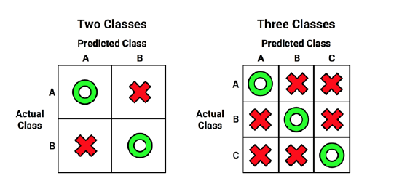

Slide 18
The most common performance measures consider the model's ability to discern one class versus all others. The class of interest is known as the positive class, while all others are known as negative.
The relationship between the positive class and negative class predictions can be depicted as a 2 x 2 confusion matrix that tabulates whether predictions fall into one of the four categories:
• True Positive (TP): Correctly classified as the class of interest
• True Negative (TN): Correctly classified as not the class of interest
• False Positive (FP): Incorrectly classified as the class of interest
False Negative (FN): Incorrectly classified as not the class of interest

Slide 19
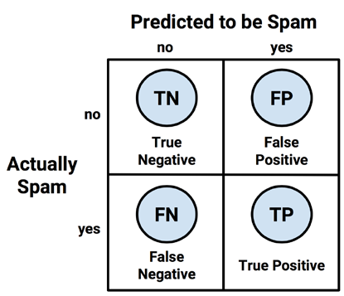

Slide 20

Using confusion matrix to measure accuracy

Slide 21


Slide 22
An easy way to tabulate a classifier's predictions into a confusion matrix is to use R's table() function. The command to create a confusion matrix for the SMS data is shown as follows. The counts in this table could then be used to calculate accuracy and other statistics:
>table(sms_results$actual_type,sms_results$predict_type)

Slide 23
If you like to create a confusion matrix with a more informative output, the CrossTable() function in the gmodels package offers a customizable solution. you will need to do so using the install.packages("gmodels") command.
By default, the CrossTable() output includes proportions in each cell that indicate the cell count as a percentage of table's row, column, or overall total counts. The output also includes row and column totals. As shown in the following code, the syntax is similar to the table() function:
> library(gmodels)
>CrossTable(sms_results$actual_type,sms_results$predict_type)

Slide 24
We can use the confusion matrix to obtain the accuracy and error rate. Since the accuracy is (TP + TN) / (TP + TN + FP + FN), we can calculate it using following command:
> (152 + 1203) / (152 + 1203 + 4 + 31)
1] 0.9748201
We can also calculate the error rate (FP + FN) / (TP + TN + FP + FN) as:
> (4 + 31) / (152 + 1203 + 4 + 31)
[1] 0.02517986
This is the same as one minus accuracy:
> 1 - 0.9748201
[1] 0.0251799

Slide 25
Other Performance Measures
The Classification and Regression Training package caret by Max Kuhn includes functions to compute many such performance measures. This package provides a large number of tools to prepare, train, evaluate, and visualize machine learning models and data.
Before proceeding, you will need to install the package using the install.packages("caret") command.

Slide 26
Caret provides measures of model performance that consider the ability to classify the positive class, a positive parameter should be specified. In this case, since the SMS classifier is intended to detect spam, we will set positive = "spam" as follows:
> library(caret)
> confusionMatrix(sms_results$predict_type,
sms_results$actual_type, positive = "spam")

Slide 27
The kappa statistic
The kappa statistic adjusts accuracy by accounting for the possibility of a correct prediction.
Kappa values range from 0 to a maximum of 1, which indicates perfect agreement between the model's predictions and the true values. Values less than one indicate imperfect agreement.

Slide 28
• Poor agreement = less than 0.20
• Fair agreement = 0.20 to 0.40
• Moderate agreement = 0.40 to 0.60
• Good agreement = 0.60 to 0.80
• Very good agreement = 0.80 to 1.00

Slide 29
Sensitivity and specificity
The sensitivity of a model (also called the true positive rate) measures the proportion of positive examples that were correctly classified. Therefore, as shown in the following formula, it is calculated as the number of true positives divided by the total number of positives, both correctly classified (the true positives) as well as incorrectly classified (the false negatives):

Slide 30


Slide 31
The specificity of a model (also called the true negative rate) measures the proportion of negative examples that were correctly classified. As with sensitivity, this is computed as the number of true negatives, divided by the total number of negatives—the true negatives plus the false positives:

Slide 32


Slide 33
Precision and recall
The precision (also known as the positive predictive value) is defined as the proportion of positive examples that are truly positive; in other words, when a model predicts the positive class, how often is it correct? A precise model will only predict the positive class in cases that are very likely to be positive. It will be very trustworthy.

Slide 34


Slide 35
On the other hand, recall is a measure of how complete the results are.
A model with a high recall captures a large portion of the positive examples, meaning that it has wide breadth. For example, a search engine with a high recall returns a large number of documents pertinent to the search query. Similarly, the SMS spam filter has a high recall if the majority of spam messages are correctly identified.

Slide 36


Slide 37
The F-measure
A measure of model performance that combines precision and recall into a single number is known as the F-measure (also sometimes called the F1 score or F-score). The F-measure combines precision and recall using the harmonic mean, a type of average that is used for rates of change. The harmonic mean is used rather than the common arithmetic mean since both precision and recall are expressed as proportions between zero and one, which can be interpreted as rates. The following is the formula for the F-measure:

Slide 39
Visualizing performance trade-offs
The ROCR package provides an easy-to-use suite of functions for visualizing the performance of classification models. It includes functions for computing large set of the most common performance measures and visualizations. Before continuing, install the package using the install.packages("ROCR") command.
To create visualizations with ROCR, two vectors of data are needed. The first must contain the predicted class values, and the second must contain the estimated probability of the positive class. These are used to create a prediction object that can be examined with the plotting functions of ROCR.

Slide 40
The prediction object for the SMS classifier requires the classifier's estimated spam probabilities and the actual class labels. These are combined using the prediction() function in the following lines:
> library(ROCR)
> pred <- prediction(predictions =sms_results$prob_spam, labels = sms_results$actual_type)
Next, the performance() function will allow us to compute measures of performance from the prediction object we just created, which can then be visualized using the R plot() function.

Slide 41
ROC Curves
The Receiver Operating Characteristic (ROC) curve is commonly used to examine the trade-off between the detection of true positives, while avoiding the false positives.
The characteristics of a typical ROC diagram are depicted in the following plot. Curves are defined on a plot with the proportion of true positives on the vertical axis and the proportion of false positives on the horizontal axis. Because these values are equivalent to sensitivity and (1 – specificity), respectively, the diagram is also known as a sensitivity/specificity plot:

Slide 42
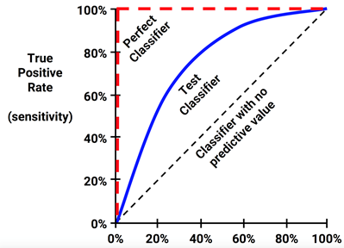

Slide 43
the diagonal line from the bottom-left to the top-right corner of the diagram represents a classifier with no predictive value. This type of classifier detects true positives and false positives at exactly the same rate, implying that the classifier cannot discriminate between the two. This is the baseline by which other classifiers may be judged. ROC curves falling close to this line indicate models that are not very useful.

Slide 44
The perfect classifier has a curve that passes through the point at a 100 percent true positive rate and 0 percent false positive rate. It is able to correctly identify all of the positives before it incorrectly classifies any negative result.
Creating ROC curves with the ROCR package involves building a performance object from the prediction object we computed earlier. Since ROC curves plot true positive rates versus false positive rates, we simply call the performance() function while specifying the tpr and fpr measures, as shown in the following code:
> perf <- performance(pred, measure = "tpr", x.measure = "fpr")

Slide 45
Using the perf object, we can visualize the ROC curve with R's plot() function. As shown in the following code lines, many of the standard parameters to adjust the visualization can be used, such as main (to add a title), col (to change the line color), and lwd (to adjust the line width):
> plot(perf, main = "ROC curve for SMS spam filter", col = "blue", lwd = 3)

Slide 46
Although the plot() command is sufficient to create a valid ROC curve, it is helpful to add a reference line to indicate the performance of a classifier with no predictive value. To plot such a line, we'll use the abline() function. This function can be used to specify a line in the slope-intercept form, where a is the intercept and b is the slope. Since we need an identity line that passes through the origin, we'll set the intercept to a = 0 and the slope to b = 1, as shown in the following plot. The lwd parameter adjusts the line thickness, while the lty parameter adjusts the type of line.
For example, lty = 2 indicates a dashed line:
> abline(a = 0, b = 1, lwd = 2, lty = 2)

Slide 47
